Slide 1
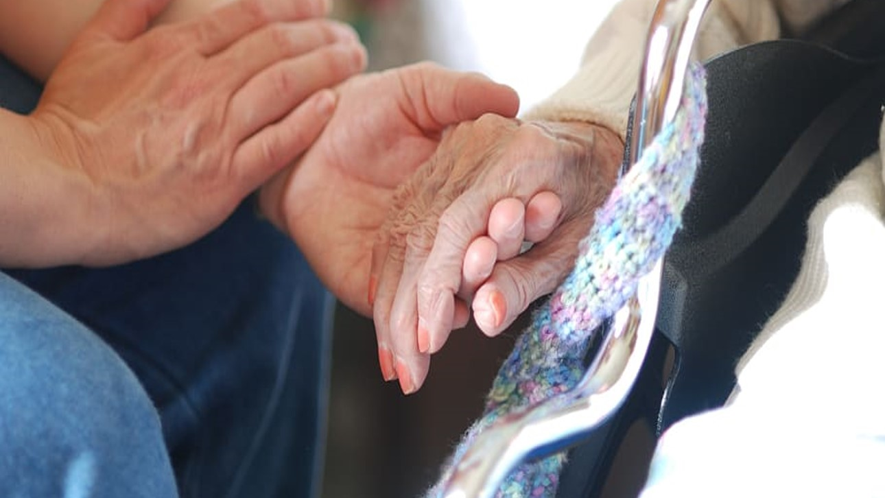

PT7003/ PT4000
Practical: Touch in Clinical Setting
Walaa Abu-Taleb

Slide 2
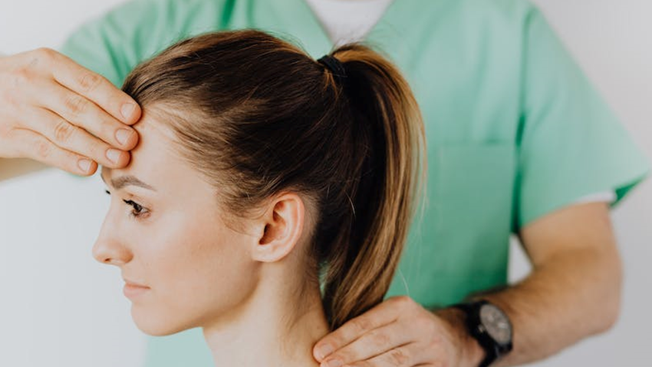
Learning Objectives
By the end of this session, you should be:
Understand the value and types of touch used in clinical setting
Be aware of own and others’ feelings in relation to touch involved in physiotherapy practice
Practice in groups how to approach and touch a colleague
Understand the boundaries of professional and unprofessional touch
Understand the boundaries of touch in different cultures.
Set ground rules for your communication with your peers.

Slide 3

Warm Up Activity
We will introduce ourselves and say something interesting about us
1- Pair up with a colleague and share an interesting fact about yourself.
2- Each pair will introduce their partner to the group.
3- Discuss your expectations of what touch in clinical settings may mean to?
Notes:
We will introduce ourselves and say something interesting about us
1- Pair up with a colleague and share an interesting fact about yourself.
2- Each pair will introduce their partner to the group.
3- Discuss your expectations of what touch in clinical settings may mean to?

Slide 4
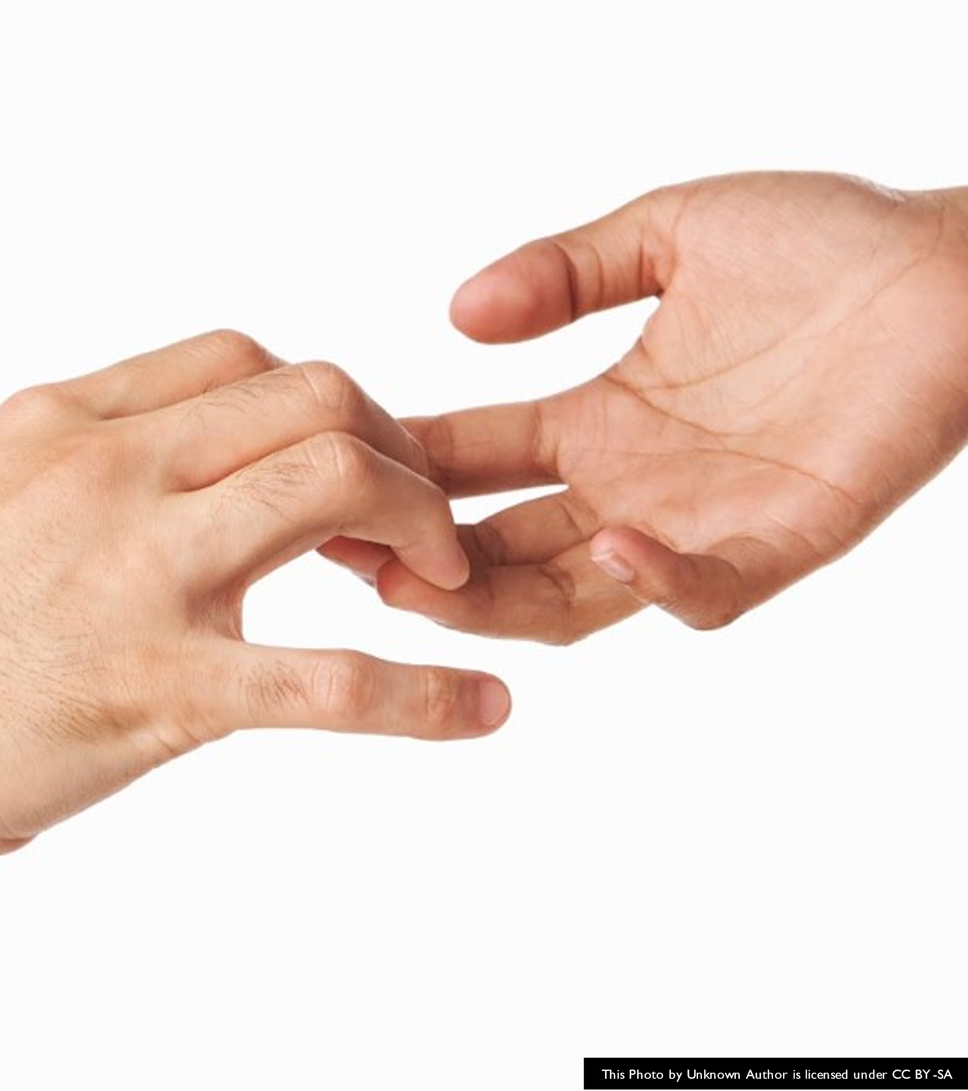

Introduction
Touch is an integral part of being human and a part of human interaction; it is manifest socially, relationally, culturally and professionally.
Health care makes considerable use of touch, and for most health professionals it is essential to their practice.
Notes:
https://www.sciencedirect.com/science/article/pii/S2468781219306198

Slide 5
Neurophysiology of human touch
The neurophysiological response to touch includes the release of specific chemicals and neurotransmitters that lead to neuroendocrine effects; vagal stimulation; reduction of stress, pain and depression; and enhancement of immunity.
Affective touch also appears to lessen allostatic load (i.e. stress) in critically ill patients, due to the positive effects on pathophysiological processes aggravated by stress, such as immune and neuroendocrine derangements and inflammation.
Notes:
https://www.ncbi.nlm.nih.gov/pmc/articles/PMC6382052/#:~:text=The%20neurophysiological%20response%20to%20touch,depression%3B%20and%20enhancement%20of%20immunity.

Slide 6

Types of Touch
Generally, touch could be differentiated into three main types:
Diagnostic/instrumental (i.e. Taking a peripheral pulse, examining the abdomen),
Therapeutic (i.e. Applying a dressing, mobilising a joint) and
Expressive (i.e. A demonstration of empathy, a signal of partnership).
This Photo by Unknown Author is licensed under CC BY-NC-ND
Notes:
Expressive touch described as unrequired spontaneous touch normally aimed at communicating compassion.
It has been viewed as an integral part of being human.
The main benefit is centred around communication of compassion and improvements in nurse-patient rapport.

Slide 7
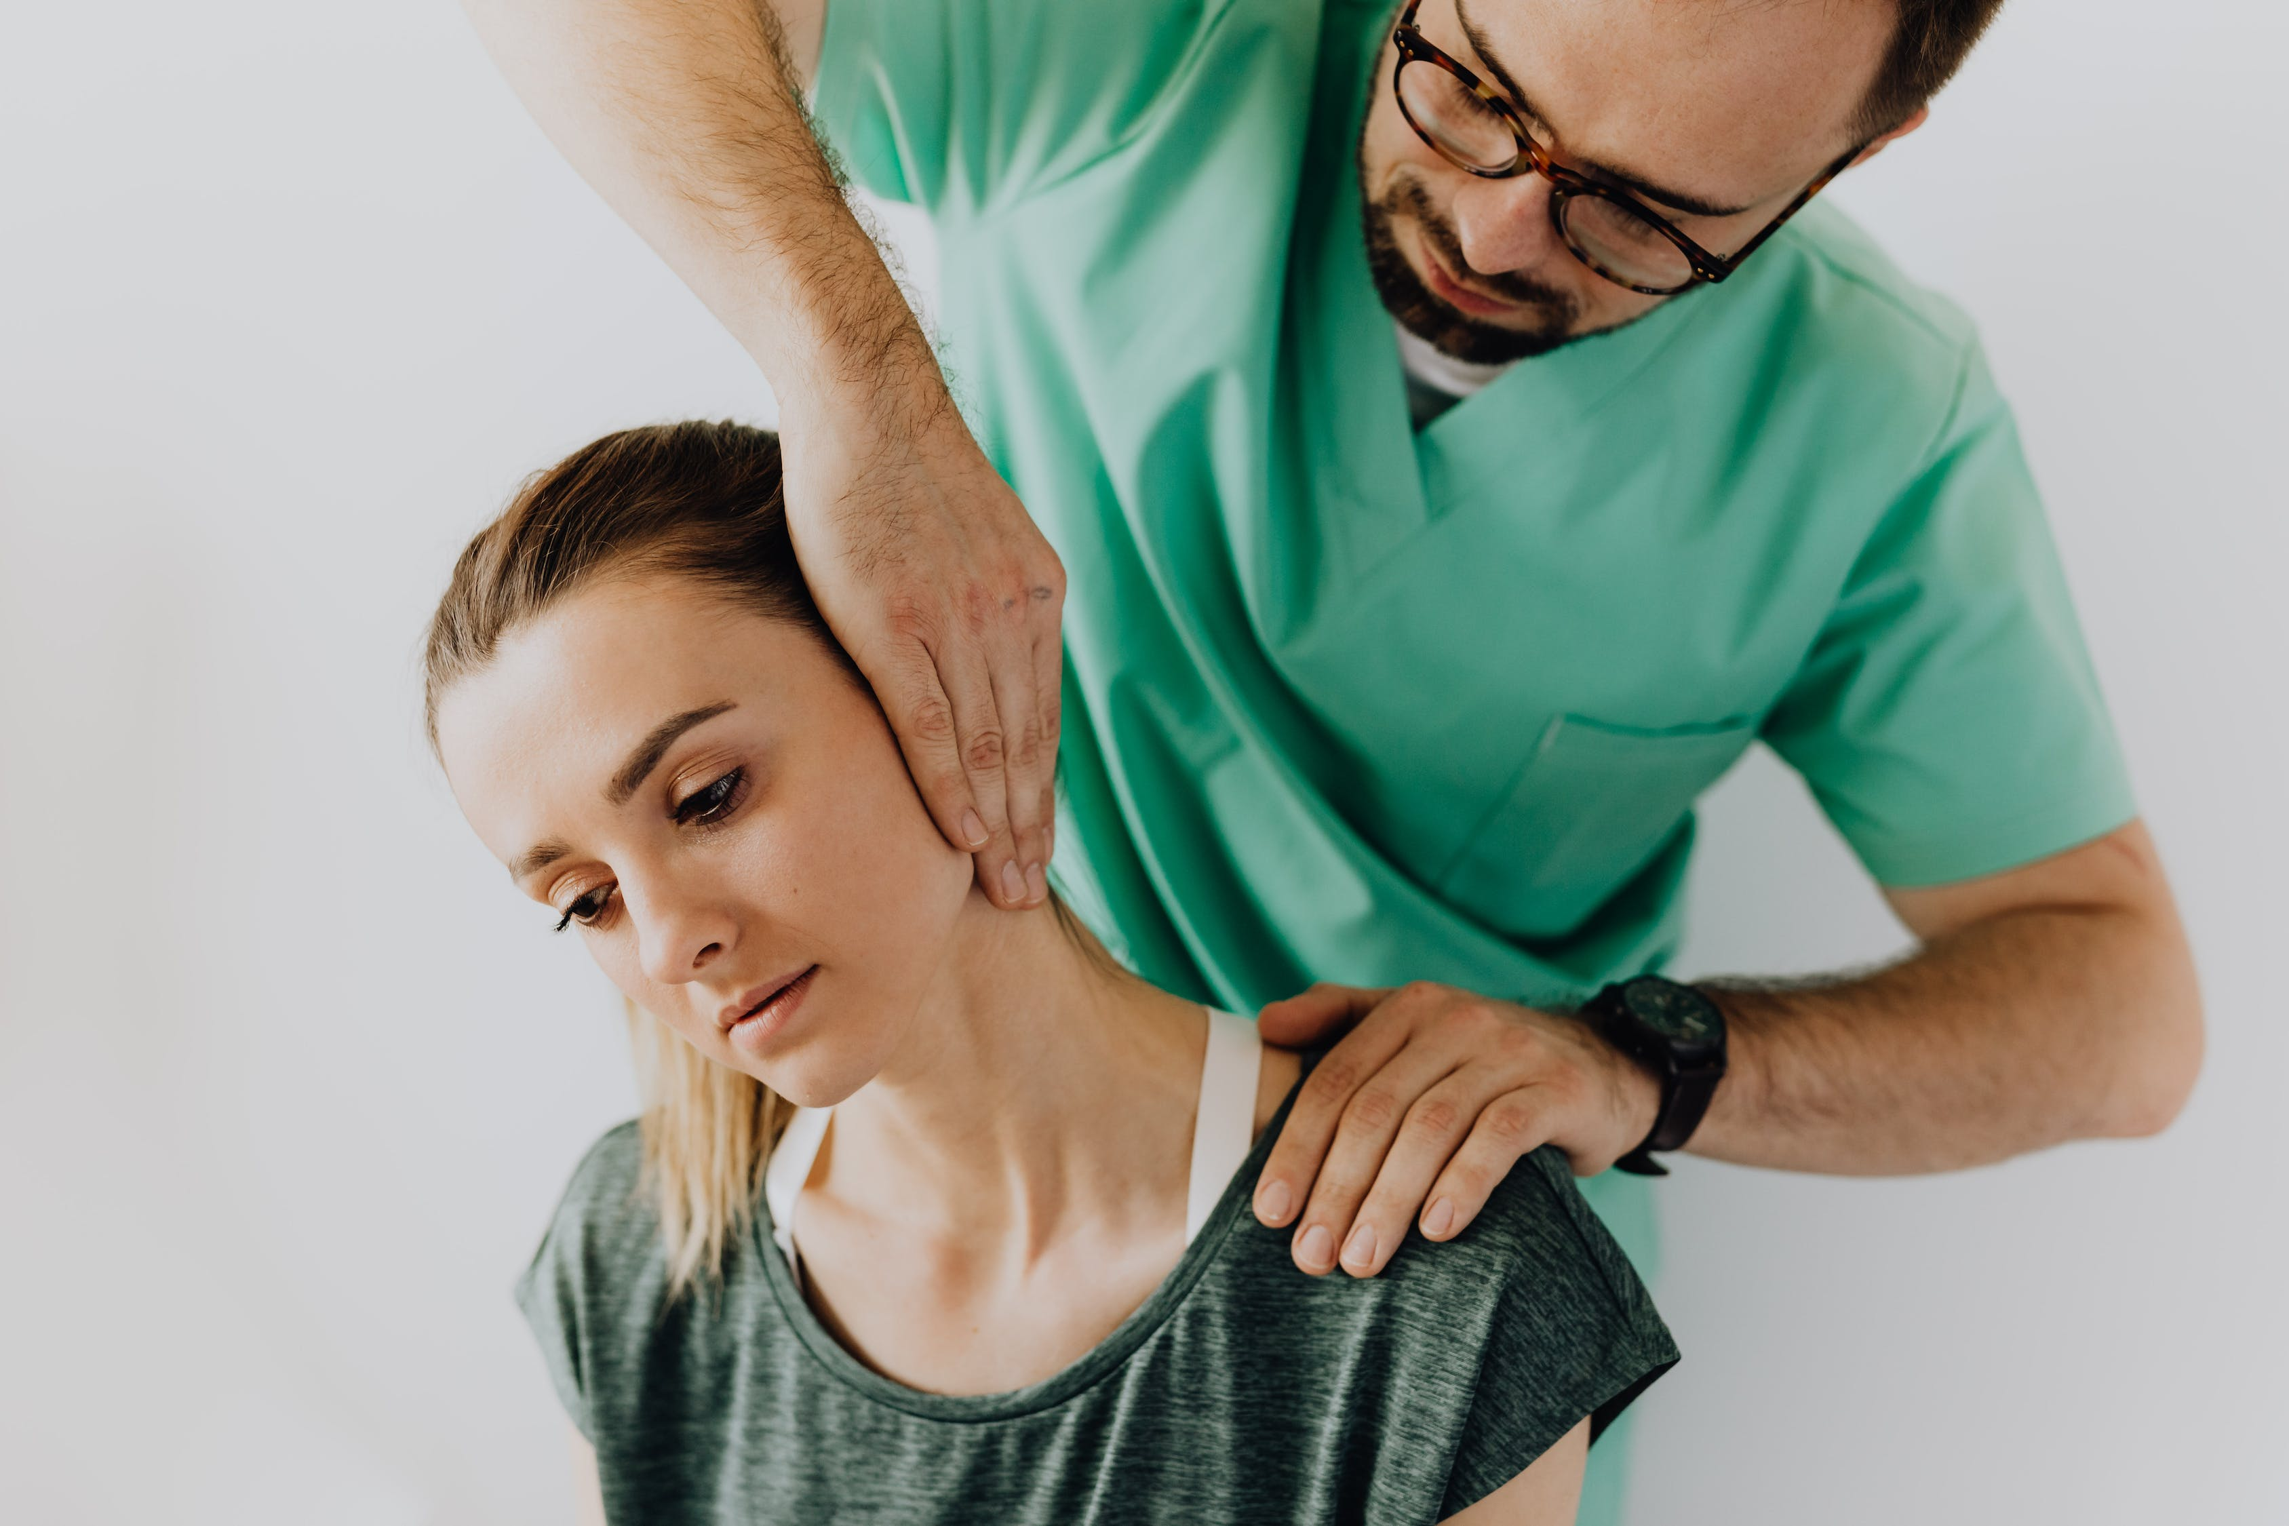
Patients Perspective
Several had had experiences with different physiotherapists, and on this basis were able to identify certain therapists as particularly “good,” and their practice as particularly powerful.
Patients saw being touched as of special importance.
As one said, “The physiotherapist touched me, my body. . .. believed me, took it (her problem) seriously. . ..”
Notes:
A large amount of evidence has identified hands-on techniques as a pain
modulator playing a role at multiple levels beyond biomechanics that
represents only one of the possible explanations of action (e.g., change in
spinal stiffness) (Zusman, 2010). Different interpretative frameworks have been
proposed to better clarify the mechanism of action of manual techniques
(Bialosky et al., 2009; Testa and Rossettini, 2016). The elicitation of
neurophysiological effects (e.g., spinal reflex and pain neural networks
modulation) and context-related effects (e.g., placebo, nocebo) provide
additional interpretations to explain why somatosensory stimuli delivered during
the application of a manual technique are capable to modulate the patient’s
processing of pain condition (Bialosky et al., 2018; Rossettini et al., 2018).

Slide 8

Novice healthcare professionals and students need to repurpose social touch, negotiate sensitive touch, and develop skills in touching for assessment and treatment.
Touch has physical, emotional, social, cultural and spiritual significance

Slide 9
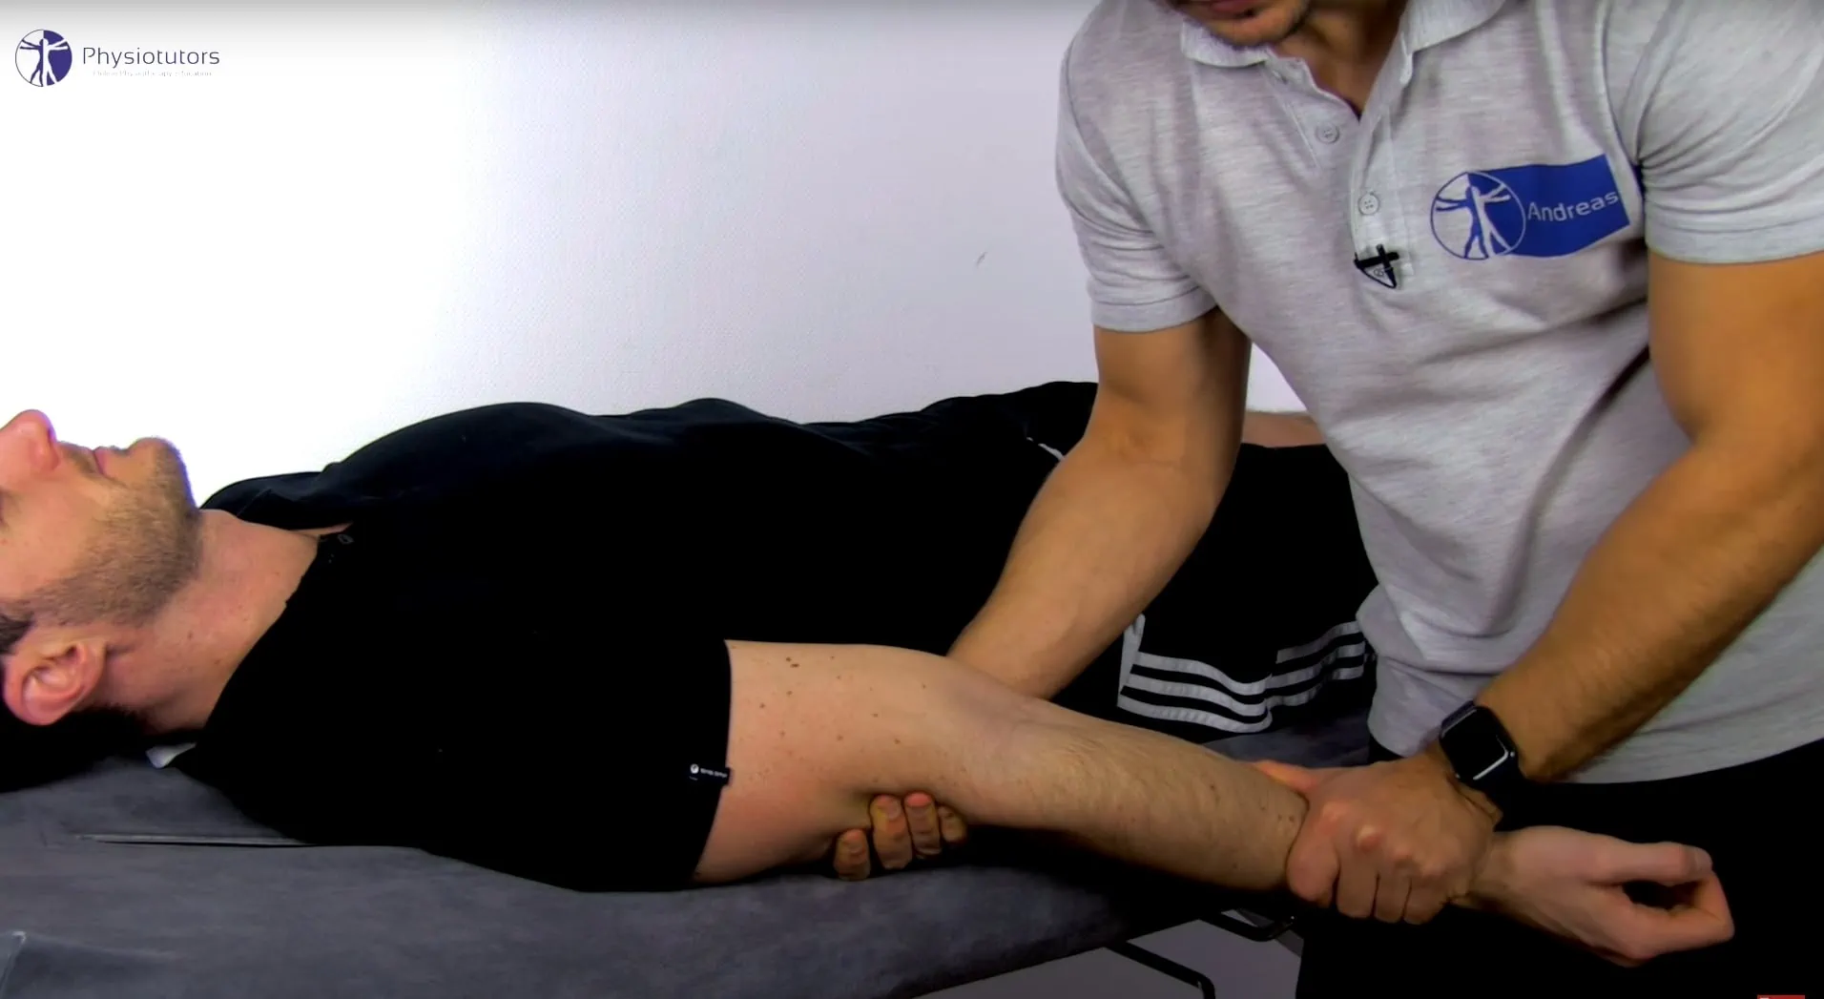
Activity 2
Let’s Practice together!
Elbow Passive ROM (PROM)
Notes:
Part of the teaching and learning experience at London met will be practical and this means practicing on others and letting others practicing on you! There will be a lot of teaching that involves palpation and manual techniques. The more you practice the better you get at it and your touch will be appropriate and professional.
To ease this and get over the possible embarrassment let’s practice together.
Teacher will demo Elbow passive ROM in supine and sitting. Students will pair and perform the movement
Emphasise on giving each other feedback, is it comfortable?
Do students use too much finger pressure.
Do they provide support for the limb?
Do they hold the limb with the tips of fingers rather than the hand?...etc
https://www.youtube.com/watch?app=desktop&v=309Q8IJDq7s

Slide 10

Protected characteristics
The Equality Act of 2010 brought together various anti-discrimination laws into one single act, so any unlawful treatment (discrimination, harassment or victimisation) relating to one of the Equality Act protected characteristics, since 2010 is covered by this area of employment law.
Notes:
Reminder that bias against protected characteristics cannot exist in physiotherapy

Slide 11
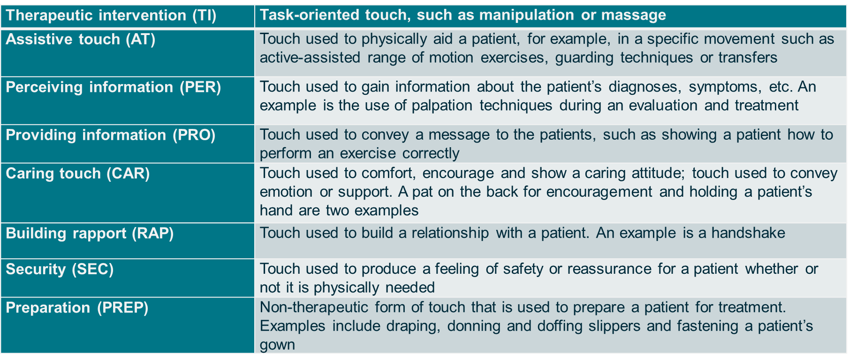
Types of touch for physiotherapists
Notes:
Roger, J., Darfour, D., Dham, A., Hickman, O., Shaubach, L. and Shepard, K. (2002) Physiotherapists’ use of touch in inpatient settings. Physiotherapy Research International 7(3): pp 170-186

Slide 12
Understanding Unprofessional Touch
unprofessional touch includes any physical contact that is inappropriate, non-consensual, or could be misinterpreted as unprofessional, sexual, or invasive.
Intent: Touch that is meant to comfort or reassure but is interpreted as invasive or inappropriate.
Context: Touch that might be appropriate in one setting but not another (e.g., social settings vs. clinical settings).
Duration and Area: Touch that lingers too long or involves sensitive areas of the body without clinical necessity

Slide 13
Consequences of Unprofessional Touch:
Legal Repercussions: Unprofessional touch can lead to legal actions, including accusations of harassment or abuse.
Ethical Implications: Such behavior breaches professional ethics and can damage the trust between healthcare professionals and patients​.
Professional Consequences: Loss of licensure, damage to reputation, and loss of patient trust.

Slide 14

Activity 3: Share your story
How do you feel about touching someone or being touched in a professional setting? What would make you feel comfortable or uncomfortable?
Think Subjectively!
This Photo by Unknown Author is licensed under CC BY
Notes:
Refer to personal believes and biases as a cause of our feelings for example: if you are a woman who might prefer a woman to touch you or a man, would it matter in relation to your sexuality? The attractiveness of the healthcare professional or patient?
Refer to the fact that a professional and safe environment must be present for both the therapist and the patient.

Slide 15
Chaperoning policy
Each trust has its own Chaperoning Policy, but they all have the same principles in Common:
Chaperones are used to protect both the therapist and the patient.
You have a duty to respect the dignity and sensibilities of your patients, as well as having your own right to work in a safe environment. By its very nature, physiotherapy is a ‘touching’ profession often with patients in a state of undress. CSP
Notes:
Chaperoning policy – Rotherham Doncaster and South Humber NHS Foundation Trust (RDaSH)

Slide 16
CSP Policy for Chaperoning
‘Close’ examinations defined as:
Examinations and/or interventions that may involve close bodily contact between patient and therapist, especially where the patient may be partially undressed
Examinations and/or interventions that may involve therapist handling of the patient close to intimate areas, the lumbo-sacral areas, and thoracic areas of female patients, especially where the patient may be partially undressed
Examinations involving complete removal of a patient’s outer clothing down to underwear
Examinations involving the partial undoing or total removal of a patient’s underwear e.g. bras
Any examination where the patient has requested a chaperone to be present
Notes:
‘Intimate’ examinations defined as:
Any invasive examination that involves the pelvic floor complex (vaginal and/or ano-rectal areas)
Any examination involving the genitalia or breasts

Slide 17

Cultural Awareness in touch
It is important to consider the types of examinations that could also be deemed intimate by some patients.
Physiotherapists need to be aware of the cultural and/or religious requirements of patients and what may constitute an intimate and/or close examination to any individual patient. CSP
This Photo by Unknown Author is licensed under CC BY-NC-ND

Slide 18
Activity 4: Discuss
Cultural Sensitivity Failure
A physiotherapist touches a patient’s head while explaining an exercise, not realizing that in the patient’s culture, touching the head is considered very disrespectful.
How can cultural differences affect the perception of touch?
What can healthcare professionals do to better understand and respect cultural sensitivities regarding touch?
Share with us

Slide 19
Boundary Setting:
Techniques and Communication

Slide 20
Boundary setting Techniques and Communication
Consent: Always ask for consent before touching and explain the purpose of the touch.
Clarity: Clearly communicate the clinical necessity of any touch and what the patient should expect.
Observation: Pay attention to verbal and non-verbal cues from the patient indicating discomfort or unease​​.

Slide 21
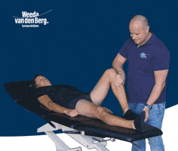
Boundary Setting Effective Communication
Before Touching: “I’m going to check the alignment of your spine now by placing my hands on your back. Is that okay with you?”
During Touching: “You might feel my hands move along your spine. This is to ensure I’m assessing all areas properly.”
After Touching: “Thank you for allowing me to conduct this part of the exam. If you have any discomfort or questions about the process, please let me know.”

Slide 22
Boundary Setting Handling Discomfort
Acknowledge: “I’m sorry that made you uncomfortable. Let’s find a way to proceed that you’re more comfortable with.”
Adapt: Modify the technique or offer alternatives that do not involve touch.
Ask: I need to perform the following technique (explain) would you like for me to modify it by …

Slide 23
Activity 5: Practice boundary setting
Practice activity No 2 where you applied Elbow Passive ROM (PROM).
Establish boundaries with your colleague:
    1- Introduce yourself and your role
    2- Explain what you will do
    3- Explain why you want to do it.
    4- Explain what the patient is expected to feel
    5- Ask for Consent
    6- Apply the technique.
    7- practice a hypothetical situation where the patient felt uncomfortable: eg a woman did not like that she needed to expose her arm to you, how will you deal with this situation?
Work in pairs

Slide 24
Setting ground rules for practice
I respect all my colleagues regardless of their protected characteristics
I understand that I need to apply the manual techniques on my colleagues and allow them to practice with me
I understand I need to give and receive the kind feedback from my colleagues as learning technique without sensitivity or personalisation
I will use the practical time to develop my hands on skills to enable myself to become a better physiotherapist every day I spend at Uni!
I will ask my colleague to let me know if they have felt uncomfortable, so I avoid letting it happen again in class or in practice
What else?

Slide 25
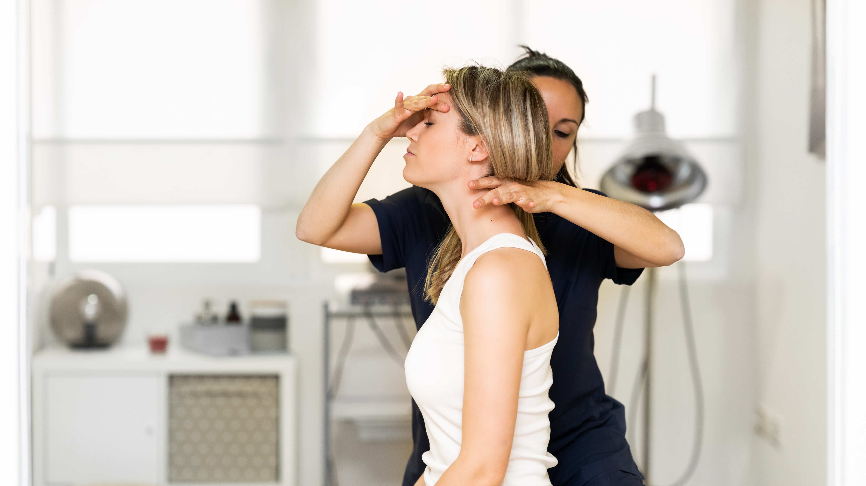
Summary
Touch is a powerful tool to use in physiotherapy.
Understanding when, why and how to use this tools is extremely important in clinical setting and in class.
Practicing hands on technique will help develop your kinesthetic skills and communication skills as well.

Slide 26

Questions?

Slide 27

THANK YOU

